Slide 1
C# Programming
MAD401

Slide 2
Introduction to C#
Lecture 1

Slide 3
Objectives
Introduction to C#
Introduction to Visual Studio
Variables
Console Input/Output
String Interpolation
Composite Formatting
Comments
Data Types & Conversions
Categories of types
Numeric types
Null and void
Conversions
Arrays

Slide 4
About C#
Originally created in 2001 by Anders Hejlsberg for Microsoft
Current version: 9.0 released Nov. 10 2020
Created as a general-purpose object-oriented language which was to supersede C++ in the .NET framework
C# is not C or C++ but inherits many features and syntax from these languages
C#’s feature-set is mostly similar to Java, however, has several key differences
C# is cross platform
Mono

Slide 5
C# Features
C# has the following features:
Strongly typed
Object-oriented (class-based)
Garbage collection
Cross platform
LINQ extension
Multi-Paradigm (Imperative / Declarative / Functional / Generic)

Slide 6
The .NET Framework
C# is a popular programming language but there are a lot of things it cannot do by itself
Graphical User Interface
Read data from files
Work with databases
C# provides only the basic keywords and operators that you need to construct a program
The .NET Framework is a collection of classes and other code that can be used along with a programming language such as C# to create programs for the Windows operating system
When you use C# to write programs, you are using a combination of the language itself and the .NET framework

Slide 7
Similarities to Java
Syntactically Similar
Garbage Collected VM Environment
Immutable Strings
Exceptions (try / catch / finally)
Object as root
Single Inheritance model
Multi-Interface model

Slide 8
Differences from Java
Keywords
base vs super
lock vs synchronized
: vs extends & implements
is vs instanceof
Namespaces vs packages
using vs import

Slide 9
Differences from Java
public String name { get; set; }
public String name { get { return _name; } set{ if(value != "") _name = value; } }
Cross Platform Support
.NET is MS only
Mono is cross platform but is missing some .NET elements
virtual keyword for polymorphism

Slide 10
Visual Studio
Visual Studio 2019 Enterprise
Powerful IDE
Supports 36 languages including Visual C#, Visual C++, Visual Basic, Java and many more
Supports Unity through plugin
Alternative to Unity’s own MonoDevelop
Load of community plugins; GitHub support

Slide 11
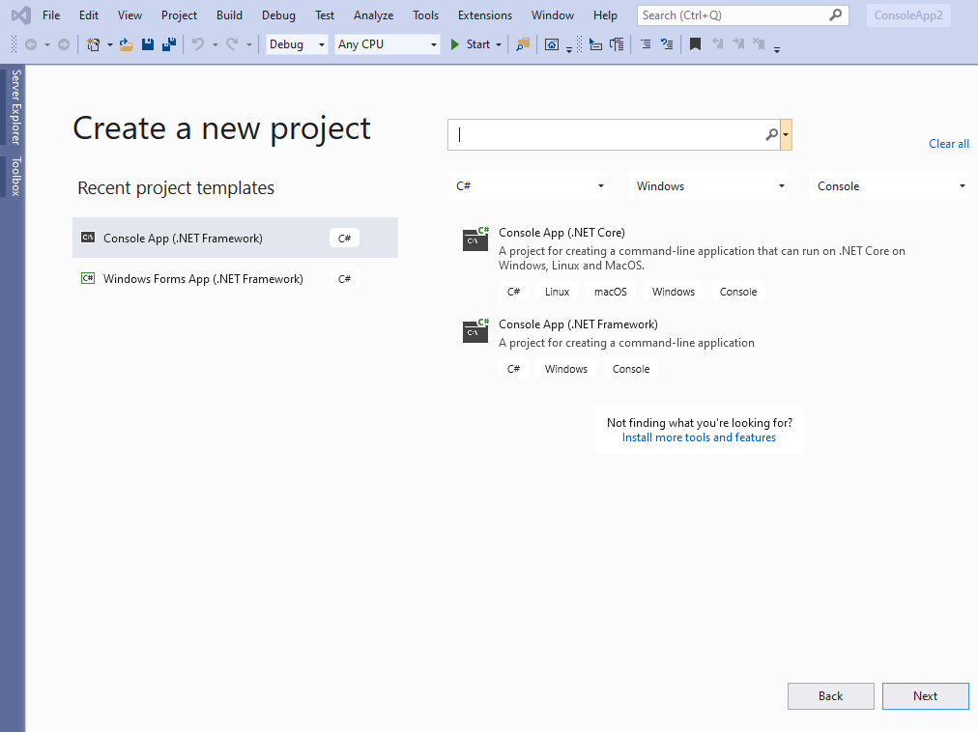

Slide 12
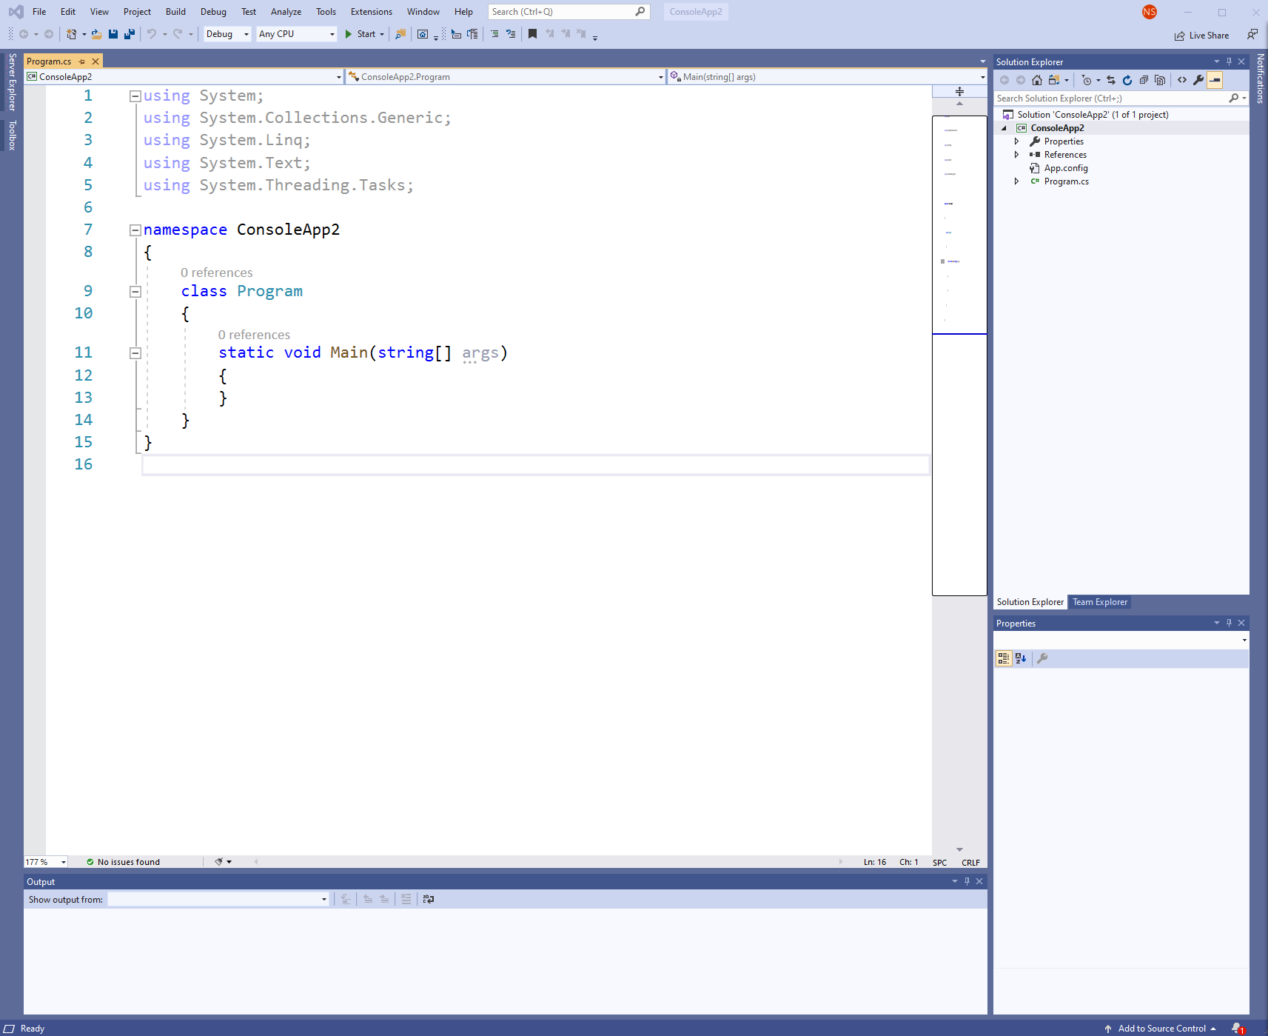
Tour of VS 2019
1
Top Navigation bar
Code Editor Window
Error/Output Window
Solution Explorer Window
Displays all source files, methods and properties available in the project
2
4
3

Slide 13
C# Basics
C# is a case sEnSiTiVe language
C# inherits its basic syntax from Java, C & C++
“semicolon language”
To compile and run a program within Visual Studio
CTRL + F5 to run without debugging
F5 to run with debugging
csc.exe helloWorld.cs (C:\Program Files (x86)\Microsoft Visual Studio\2017\Enterprise\MSBuild\15.0\Bin\Roslyn)

Slide 14
Common Language Infrastructure
The C# compiler transforms the C# source file into a language known as Common Intermediate Language (CIL), or IL for short. An additional step, usually performed at execution time, is required to change the CIL code into machine code that the processor can understand.
This involves an important element in the execution of a C# program: the Virtual Execution System (VES). The VES, also casually referred to as the runtime, compiles CIL code as needed (a process known as just-in-time compilation or jitting).

Slide 15
Common Language Infrastructure
The code that executes under the context of an agent such as the runtime is termed managed code, and the process of executing under control of the runtime is called managed execution. The code is “managed” because the runtime controls significant portions of the program’s behavior by managing aspects such as memory allocation, security, and just-in-time compilation.
Code that does not require the runtime to execute is called native code (or unmanaged code).
-- Essential C# 6.0 5/e Mark Michaelis with Eric Lippert

Slide 16
Common Runtime Language
Running within the context of a CLI implementation enables support for the following features:
Language interoperability - interoperability between different source languages. This is possible because the language compilers translate each source language to the same intermediate language (CIL).
Type safety - checks for conversion between types, ensuring that only conversions between compatible types will occur. This helps prevent the occurrence of buffer overruns, a leading cause of security vulnerabilities.
Code access security

Slide 17
Common Runtime Language
Running within the context of a CLI implementation enables support for the following features:
Garbage collection – memory management that automatically de-allocates memory previously allocated by the runtime
Platform portability – support for potentially running the same assembly on a variety of operating systems. One obvious restriction is that no platform-dependent libraries are used; therefore, as with Java, there are potentially some platform-dependent idiosyncrasies that need to be worked out.

Slide 18
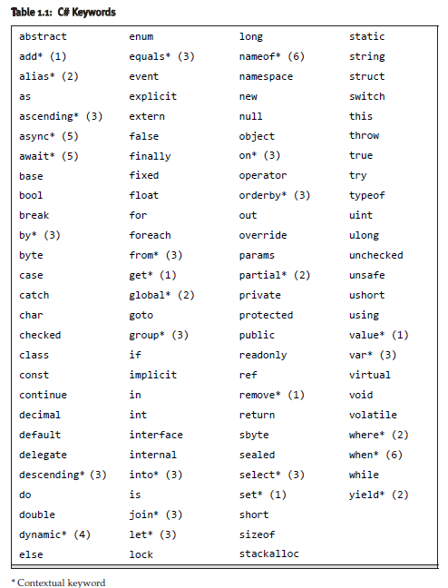
C# keywords

Slide 19
C# Identifiers
C# identifiers follow the same convention as Java
Variable names may begin with any letter or an underscore (_), followed by any number of letters, numbers, and/or underscores.
By convention, local variable names are camelCased and do not include underscores.
PascalCase is preferred in class identifiers. Unlike Java, the main method also requires PascalCase.
static void Main(string[] args) {
}

Slide 20
C# Identifiers & Variables
C# statements end with a semi colon ( ; )
One difference between Java is that the switch statement does not require a semicolon at the end
Just like Java, whitespace is ignored by the compiler
Variables and datatypes work similarly with C#
To declare a variable is to define it, which you do by
Specifying the type of data which the variable will contain
Assigning it an identifier (name)

Slide 21
Assigning a Variable
After declaring a local variable, you must assign it a value before reading from it.
using System;
namespace Mad401.Lecture1 {
class Program {
static void Main(string[] args) {
string student;
string professor = "Nicholas";
student = "John Smith";
student = "Jane Doe";
}
}
}

Slide 22
More on Strings
Assignment statements return a value, therefore, two assignments are allowed within the same statement
Strings are Immutable
Changing a string value requires re-assignment (different memory location)

Slide 23
Console Input/Output
Data can be output to the console by using the methods part of the Console class (C#’s version of Java’s System)
Console.WriteLine() will add a newline character automatically after the end of the string
Console.Write() works similarly except it avoids adding a newline character

Slide 24
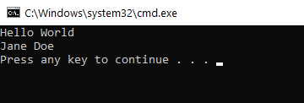
Hello World
Our first C# program…
using System;
using System.Collections.Generic;
using System.Linq;
using System.Text;
using System.Threading.Tasks;
namespace Mad401.Lecture1 {
class Program {
static void Main(string[] args) {
string student;
string professor = "Nicholas";
student = "John Smith";
student = "Jane Doe";
Console.WriteLine("Hello World");
Console.WriteLine(student);
}
}
}

Slide 25
Console Input/Output
Console.ReadLine() is used to retrieve a line of information (until user presses enter), generally from the keyboard
using System;
using System.Collections.Generic;
using System.Linq;
using System.Text;
using System.Threading.Tasks;
namespace Mad401.Lecture1 {
class Program {
static void Main(string[] args) {
string name;
Console.WriteLine("Please enter your name:");
name = Console.ReadLine();
Console.WriteLine(name);
}
}
}

Slide 26
Console Input/Output
Console.ReadLine() method returns a string of text
There exists a Console.ReadKey() , which will return a single character (does not require the enter key to be pressed). Note: the data type returned is a ConsoleKeyInfo object.
This character value must be called by accessing the .Key property of the object
using System;
namespace Mad401.Lecture1 {
class Program {
static void Main(string[] args) {
Console.WriteLine("Please enter a character:");
ConsoleKeyInfo value = Console.ReadKey();
Console.WriteLine(value.Key);
}
}
}

Slide 27
Console Input/Output
Note the use of string interpolation in the next example
With string interpolation, the compiler interprets the interior of the curly brackets within the string as regions in which you can embed code (expressions) that the compiler will evaluate and convert to strings
Instead of executing code individually and combining the results as a string at the end

Slide 28
String Interpolation
using System;
namespace Mad401.Lecture1 {
class Program {
static void Main(string[] args) {
string firstName;
string lastName;
Console.WriteLine("Hey you!");
Console.Write("Enter your first name: ");
firstName = Console.ReadLine();
Console.Write("Enter your last name: ");
lastName = Console.ReadLine();
Console.WriteLine($"Your full name is { firstName } { lastName }.");
Console.WriteLine(new String('-', 20));
}
}
}

Slide 29
String Interpolation
The string interpolation syntax prefixes a string literal with a dollar symbol and then embeds the expressions within curly brackets.
firstName and lastName are simple expressions that refer to variables.
Console.WriteLine($"Your full name is { firstName } { lastName }.");

Slide 30
Composite Formatting
Before C# 6.0, composite formatting had to be used instead of string interpolation
A format string is provided which contains indexed placeholders for data insertion
Each placeholder corresponds with the order of arguments that appear after
Note: The index starts with 0 as with arrays
Note: The indexes do not need to appear in order
Console.WriteLine("Your full name is {0} {1}.", firstName, lastName);

Slide 31
C# Style Comments
Similar to Java
// single line comments
/* multi line comments */

Slide 32
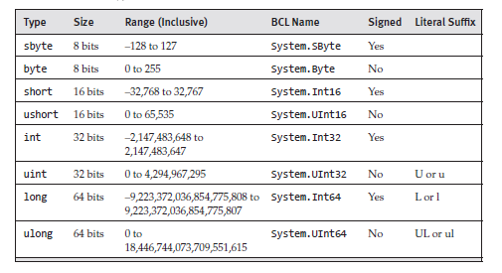
C# Integer Data Types
There are eight C# integer types:

Slide 33
C# Data Types
All the fundamental types in C# have both a short name and a full name. The full name corresponds to the type as it is named in the Base Class Library (BCL).

Slide 34
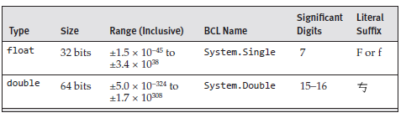
C# Floating-Point Data Types
C# supports two binary floating-point number types:

Slide 35
C# Data Types
C# also provides a decimal floating-point type with 128bit precision
Primarily used for financial calculations
C# offers a primitive Boolean type represented by true or false
C# has a char type which represents a 16-bit character from the UTF-16 encoding standard
Char is the same size as a 16-bit unsigned integer; a value between 0 and 65,535

Slide 36
C# String Data Types
Similar to Java, the string type in C# is string
In C#, you can use the @ symbol in front of a string to signify that a backslash or whitespace should not be interpreted as the beginning of an escape sequence.
Note that string literals can be combined with string interpolation by specifying the “$” prior to the “@” symbol, as in this example:
Since this is a string literal, the text will output on two lines.
Console.WriteLine($@"Your full name is:
{ firstName } { lastName }.");

Slide 37
Helpful string methods
Compare
Will return 0 if equal, negative if first < second and positive if first > second
ToLower / ToUpper
Converts string to uppercase or lowercase
int result = string.Compare("foo", "bar");
string severity = "warning";
// Display the severity in uppercase
Console.WriteLine(severity.ToUpper());

Slide 38
Helpful string methods
Trim
Removes any whitespace before or after the end of the string
Replace
Replaces any character with another in a string
Console.Write("Please enter your name: "); string name = Console.ReadLine().Trim();
string filename = "file1?.cs";
// Remove ?'s from the string
filename = filename.Replace("?", "");

Slide 39
Helpful string methods
Length
Returns the total character count of the string
string firstname = "Nicholas";
Console.WriteLine($"The name {firstname} has {firstname.Length} characters");

Slide 40
Helpful string methods
Method | Description
StartsWith / EndsWith | Determines whether the start / end of this string matches a specified string
Contains | Returns a Boolean indicating whether a specified substring occurs within this string
IndexOf | Reports the zero-based index of the first occurrence of a specified character or string. Returns -1 if the character or string is not found
Insert | Returns a new string in which a specified string is inserted at a specified index position
IsNullOrEmpty / IsNullOrWhiteSpace | Indicates whether the specified string is null or an empty string ("") / or consists only of white-space characters
Join | Concatenates the elements of a specified array or collection, using the specified separator between each element
PadLeft / PadRight | Returns a new string of a specified length in which the beginning of the current string is padded with spaces or with a specified character.
Remove | Returns a new string in which a specified number of characters from the current string are deleted.
Split | Returns a string array that contains the substrings that are delimited by elements of a specified string or character array.
Substring | Retrieves a substring from this instance.

Slide 41
C# Data Types
null and void are two additional types
null does not refer to any valid object
void is used to indicate an absence of a type or value

Slide 42
Implicitly Typed Variables
Starting in C# 3.0, implicitly typed local variables could be declared using the var keyword as long as the code initializes a variable at declaration time with an expression of unambiguous type.
The compiler will determine the data type of the initializing expression and declares the variable accordingly
var superman = "Clark Kent";
Console.WriteLine(superman);

Slide 43
Type Conversion
Explicit casting is the most common conversion operation
In C#, you cast using the cast operator; by specifying the type you would like to convert to within parentheses
Note: a loss of precision or data may occur when explicitly casting
long number = 4952352;
int number2 = (int)number;
char letter = 'N';
int number3 = (int)letter;

Slide 44
Type Conversion
When converting from an int type to a long type there is no loss of precision, therefore, the code only needs to specify the assignment operator; this conversion is called an implicit conversion
int number4 = 123456789;
long number5 = number4;

Slide 45
Type Conversion w/o Casting
When you cannot explicitly or implicitly convert from one type to another such as string to numeric, methods such as Parse() and TryParse() are required
The difference between Parse() and TryParse() is that a TryParse() will return a boolean false if the conversion fails instead of the usual exception
This can be especially useful within conditional statements
string someNewNumber = "8675309";
int convertedNumber = int.Parse(someNewNumber);

Slide 46
Type Conversion w/o Casting
using System;
namespace Mad401.Lecture1 {
class Program {
static void Main(string[] args) {
string someNewNumber = "8675309";
int convertedNumber = int.Parse(someNewNumber); //Could cause an exception
if (int.TryParse("12345678", out convertedNumber)) { //Can't cause an exception
Console.WriteLine("Conversion Successful");
} else {
Console.WriteLine("Conversion Failed");
}
}
}
}

Slide 47
Handling Exceptions
As with most modern programming languages, C# allows you to write code that responds to exceptions when they are thrown to prevent programs from abruptly crashing.
C# follows the same try-throw-catch method discussed in PHP.
Try blocks are followed by groups of statements that could potentially throw an exception.
Catch blocks contain code which is executed if the code in the try block throws an exception.

Slide 48
Type Conversion w/ Casting
using System;
namespace Mad401.Lecture1 {
class Program {
static void Main(string[] args) {
string someNewNumber = "8675309abc";
try {
int convertedNumber = int.Parse(someNewNumber); //Causes an exception
} catch(Exception ex) {
Console.WriteLine(ex.Message); // Input string was not in a correct format.
}
}
}
}

Slide 49
Arrays
Arrays work similarly to Java, however one key difference is that the square brackets for an array always appear immediately following the data type instead of after the variable declaration
This keeps all the type information together instead of splitting it up
All the above initializations are valid in C#
Note: If no initialization values are provided, default values are assigned.
string[] languages = { "C", "C#", "C++", "PHP", "Java" };
string[] languages2 = new string[] { "C", "C#", "C++", "PHP", "Java" };
string[] languages3 = new string[5] { "C", "C#", "C++", "PHP", "Java" };
string[] languages4 = new string[1];
languages4[0] = "C";

Slide 50
Arrays
Array sizes can be defined at runtime
The Length property will return the length of the array
Note: Arrays are fixed length data structures
Array accessing is performed exactly the same was as in Java, using square bracket notation.
string[] groceryList;
Console.Write("How many items on the list? ");
int size = int.Parse(Console.ReadLine());
groceryList = new string[size];
Console.Write(groceryList.Length);

Slide 51
Array Methods
Fun Fact: C++ traditionally does not check array bounds before you access elements potentially causing a problem called a buffer overrun.
However, the CLR protects C# and managed C++ code from buffer overruns.
Arrays include helpful methods such as Sort(), BinarySearch(), Reverse(), Clear() and Clone()
Note: The Array must be sorted before the binary search method can be run
Array.Sort(languages);
int index = Array.BinarySearch(languages, "searchString");
Array.Reverse(languages);
Array.Clear(languages, 0, languages.Length);

Slide 52
Array Methods
Single dimensional arrays can be resized using the Array.Resize() method.
This method allocates a new array with the specified size, copies elements from the old array to the new one, and then replaces the old array with the new one
Note: If the new size is less than the Length of the old array, a new array is allocated and elements are copied from the old array to the new one until the new one is filled; the rest of the elements in the old array are ignored.
string[] languages2 = new string[] { "C", "C#", "C++", "PHP", "Java" };
Console.WriteLine($"Array languages2 has a length of: {languages2.Length}"); //Outputs 5 Array.Resize(ref languages2, languages2.Length + 5); Console.WriteLine($"Array languages2 has a length of: {languages2.Length}"); //Outputs 10

Slide 53
Array Methods
Array.Copy() copies a range of elements in one Array to another Array and performs type casting and boxing as required
The method can take up to 5 parameters.
public static void Copy (Array sourceArray, long sourceIndex, Array destinationArray, long destinationIndex, long length);
More information including examples can be found here:
https://docs.microsoft.com/en-us/dotnet/api/system.array.copy?view=net-5.0

Slide 54
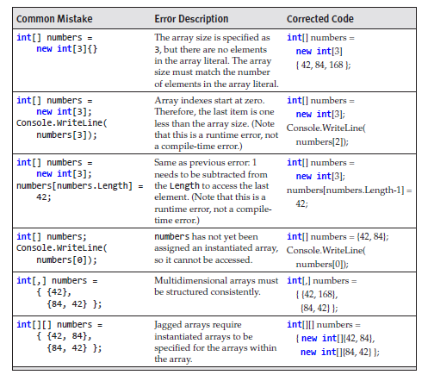
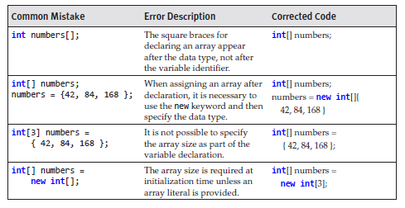
Common Array Mistakes
Essential C# 6.0 5/e Mark Michaelis with Eric Lippert

Slide 55
The end of Lecture 01

